Slide 1
Java Graphics
Liang, Introduction to java Programming, Ninth Edition, Pearson Education

Slide 2
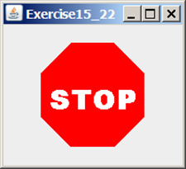
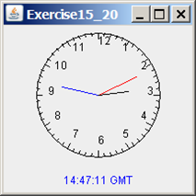
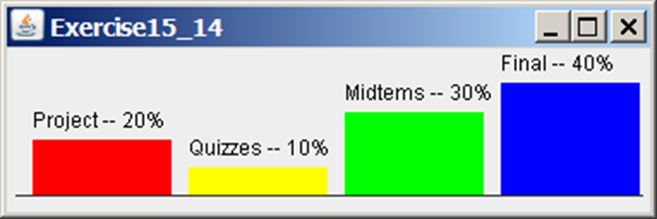
Motivation
If you want to draw shapes such as a bar chart, a clock, or a stop sign, how do you do it?

Slide 3
The Graphics Class: java.awt.graphics
The Graphics class provides the methods for drawing strings, lines, rectangles, ovals, arcs, polygons and polylines.
Think of a GUI component as a piece of paper and the graphics class object as a pencil or paintbrush.
To paint, you need to specify WHERE to paint. Each component has its own coordinate system with the origin at the upper left hand corner.

Slide 4
The Java Coordinate System

Slide 5
Each GUI Component Has its Own Coordinate System

Slide 6
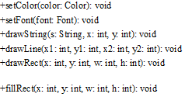
Graphics Class Methods
You can draw strings, lines, rectangles, ovals, arcs, polygons, and polylines, using the methods in the Graphics class. Some examples:

Slide 7
The Paint Component Method
We will put all of our drawing code into a paintComponent method. We will pass it a Graphics object to use to draw.
paintComponent redraws your graphics area in a JPanel, not in a JFrame.
There are two ways paintComponent() can get called. One is automatic, the other is up to you.

Slide 8
Automatic Draw
The computer's window manager automatically calls for your program to redraw its graphics whenever a window it owns appears to need redrawing.
For instance, when the window initially appears on screen. Or maybe the window had been minimized, and has just been restored.
When these sort of things happen, the Java Runtime Environment calls the paint() method for your container.
In our discussion so far, our container has been a JFrame. It will be a "heavyweight" component. Once the container redraws itself, it'll pass the command down to its children, that is, the lightweight components that live inside it.
A lightweight component from the Swing package uses the paintComponent() method to redraw itself. So that's what gets called.

Slide 9
Setting up paintComponent()
This means you want to set up paintComponent() to draw things the way you want them when it gets called.
If you're doing drawings that don't change, then you don't need to look up any information.
If you're doing anything animated or that otherwise changes over time, you need to have paintComponent() be able to look things up at the time of drawing to properly reflect conditions in the drawing.

Slide 10
When you want to Redraw
Now, let's say you've changed something in your program and you want to redraw to show the change.
You probably don't want to wait until the window manager thinks your window needs redrawing. If nobody is changing things on the screen otherwise, it may not redraw until way too late!
If you have new information you want depicted on screen, call repaint().

Slide 11
paintComponent Example
In order to draw things on a component, you will actually draw in a JPanel that is created for that purpose.
You will need to define a class that extends JPanel and overrides its paintComponent method to specify what to draw.
This program demonstrates drawing a line and a text string using paintComponent.

Slide 12
paintComponent creates a message
First, we create our project with a JFrame class called TestPaintComponent:
public class TestPaintComponent extends JFrame {
Add a new Panel() to the constructor of the class:
public TestPaintComponent() {
add(new NewPanel());
}
Now add main and set the project properties:
public static void main(String[] args) {
TestPaintComponent frame = new TestPaintComponent();
frame.setTitle("TestPaintComponent");
frame.setSize(200, 100);
frame.setLocationRelativeTo(null); // Center the frame
frame.setDefaultCloseOperation(JFrame.EXIT_ON_CLOSE);
frame.setVisible(true);
}
}

Slide 13
paintComponent creates a message, cont.
Create the NewPanel:
class NewPanel extends JPanel {
And override the paintComponent method, passing it a Graphics object:
@Override
protected void paintComponent(Graphics g) {
super.paintComponent(g);
g.drawLine(0, 0, 50, 50);
g.drawString("Banner", 0, 40);
}
}

Slide 14
Drawing Geometric Figures
Drawing Strings
Drawing Lines
Drawing Rectangles
Drawing Ovals
Drawing Arcs
Drawing Polygons

Slide 15


Drawing Strings

Slide 16
Drawing Rectangles
drawRect(int x, int y, int w, int h);
fillRect(int x, int y, int w, int h);

Slide 17
Drawing Rounded Rectangles
drawRoundRect(int x, int y, int w, int h, int aw, int ah);
fillRoundRect(int x, int y, int w, int h, int aw, int ah);

Slide 18
Drawing Ovals
drawOval(int x, int y, int w, int h);
fillOval(int x, int y, int w, int h);

Slide 19
Drawing Arcs
drawArc(int x, int y, int w, int h, int angle1, int angle2);
fillArc(int x, int y, int w, int h, int angle1, int angle2);

Slide 20
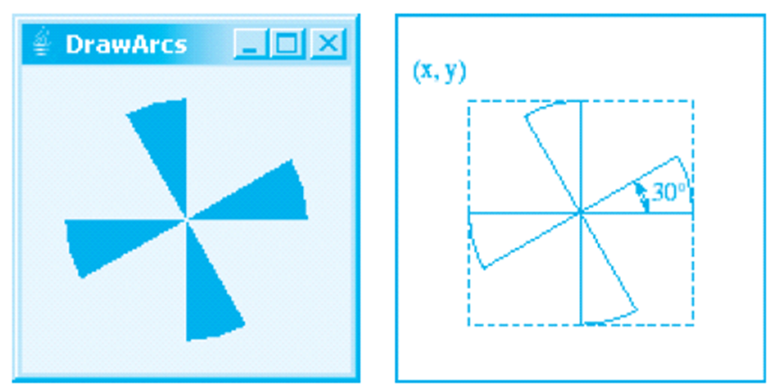
Drawing Arcs Example

Slide 21
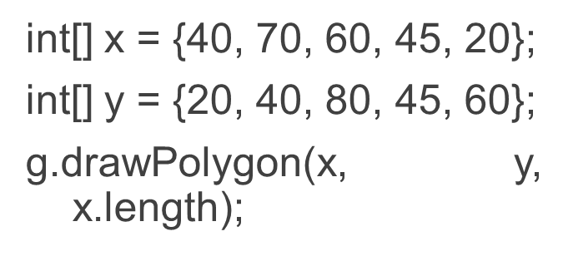
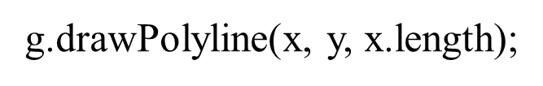
Drawing Polygons and PolyLines

Slide 22
Drawing Polygons Using the Polygon Class
Polygon polygon = new Polygon();
polygon.addPoint(40, 59);
polygon.addPoint(40, 100);
polygon.addPoint(10, 100);
g.drawPolygon(polygon);

Slide 23
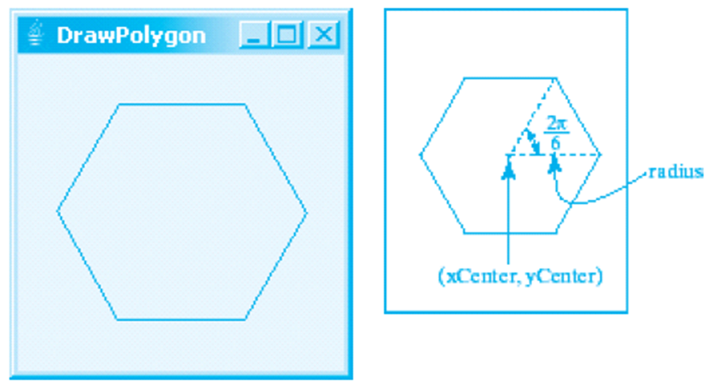
Drawing Polygons Example

Slide 24
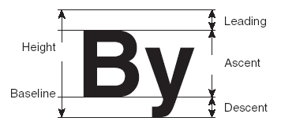
Centering Display Using the FontMetrics Class
You can display a string at any location in a panel. Can you display it centered? To do so, you need to use the FontMetrics class to measure the exact width and height of the string for a particular font. A FontMetrics can measure the following attributes:
public int getAscent()
public int getDescent()
public int getLeading()
public int getHeight()
public int stringWidth(String str)
getLeading()
getHeight()
getAscent()
getDescent()

Slide 25
The Font Metrics Class
FontMetrics is an abstract class. To get a FontMetrics object for a specific font, use the following getFontMetrics methods defined in the Graphics class:
public FontMetrics getFontMetrics(Font f)
Returns the font metrics of the specified font.
public FontMetrics getFontMetrics()
Returns the font metrics of the current font.

Slide 26
Case Study: Message Panel – Welcome to Java
This case study develops a useful class that displays a message in a panel.
The class enables the user to set the location of the message, center the message, and move the message with the specified interval.

Slide 27
Message Panel Case Study

Slide 28
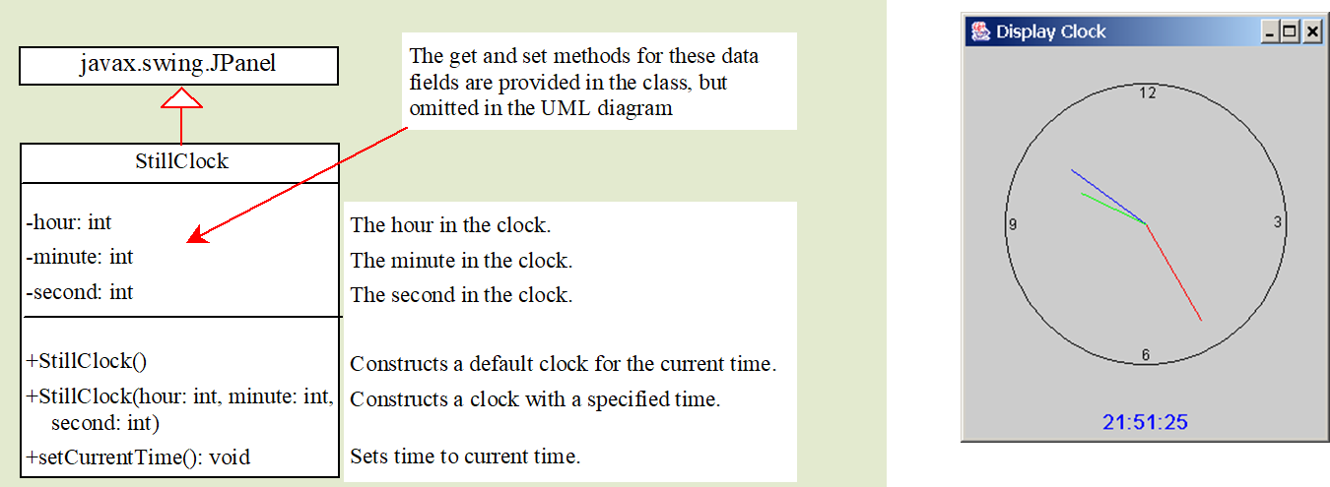
Still Clock Case Study

Slide 29
Drawing the ClocK
xEnd = xCenter + handLength  sin()
yEnd = yCenter - handLength  cos()
The position of the minute hand is determined by the minute and second. The exact minute value combined with seconds is minute + second/60. For example, if the time is 3 minutes and 30 seconds. The total minutes are 3.5. Since there are sixty minutes in one hour, the angle for the minute hand is
(minute + second/60) × (2π/60)
Since one circle is divided into twelve hours, the angle for the hour hand is
(hour + minute/60 + second/(60 × 60))) × (2π/12)

Slide 30
Displaying Image Icons
You can create image icons and display image icons in labels and buttons. For example, the following statements create an image icon and display it in a label:
ImageIcon icon = new ImageIcon("image/us.gif");
JLabel jlblImage = new JLabel(imageIcon);
An image icon displays a fixed-size image. To display an image in a flexible size, you need to use the java.awt.Image class. An image can be created from an image icon using the getImage() method as follows:
Image image = imageIcon.getImage();

Slide 31
Displaying Images
Using a label as an area for displaying images is simple and convenient, but you don't have much control over how the image is displayed. A more flexible way to display images is to use the drawImage method of the Graphics class on a panel. Four versions of the drawImage method are shown here.

Slide 32

Displaying Images Example
This example gives the code that displays an image from image/us.gif.
The file image/us.gif is under the class directory.
The Image from the file is created in the program.
The drawImage method displays the image to fill in the whole panel, as shown in the figure.

Slide 33
The Image Viewer Class
Displaying an image is a common task in Java programming. This case study develops a reusable component named ImageViewer that displays an image in a panel. The ImageViewer class contains the properties image, imageFilename, stretched, xCoordinate, and yCoordinate.

Slide 34
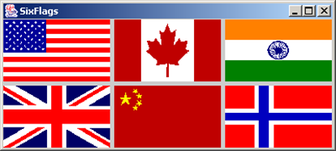
Image View Example
This example gives an example that creates six images using the ImageViewer class.

